Slide 1
Questions About the Data
Pravin Y Pawar
Largely adapted from Machine Learning Engineering
By Andriy Burkov

Slide 2
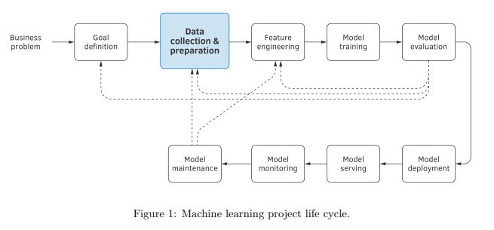
Need
The data available to the analyst is
not always “right”
not always in a form that a machine learning algorithm can use
Discuss
the properties of good quality data,
typical problems a dataset can have
Questions about data
Is the Data Accessible?
Is the Data Sizeable?
Is the Data Useable?
Is the Data Understandable?
Is the Data Reliable?

Slide 3
Is the Data Accessible?
Does the data you need already exist?
If yes, is it accessible (physically, contractually, ethically, or from a cost perspective)?
If you are purchasing or re-using someone else’s data sources, have you considered how that data might be
used or shared?
Do you need to negotiate a new licensing agreement with the original supplier?
If the data is accessible, is it protected by copyright or other legal norms?
If so, have you established who owns the copyright in your data?
Might there be joint copyright?
Is the data sensitive (e.g., concerning your organization’s projects, clients, or partners, or it is classified by the
government), and are there any potential privacy issues? If so, have you
discussed data sharing with the respondents from whom you collected the data?
Can you preserve personal information for a long-term so that it can be used in the future?
Do you need to share the data along with the model? If so, do you need to get written consent from owners or
srespondents?
Do you need to anonymize data?
Even if it’s physically possible to get the data you need, don’t work with it until all the above questions are resolved.

Slide 4
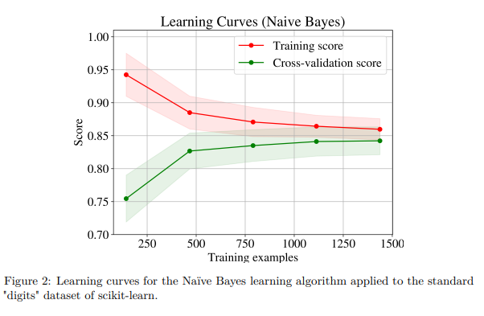
Is the Data Sizeable?
The question for which would like to have a definitive answer is whether there’s enough data
However, as already found out, it’s usually not known how much data is needed to reach the goal,
especially if the minimum model quality requirement is stringent
If have doubts about the immediate availability of sufficient data,
need find out how frequently new data gets generated
For some projects, can start with what’s initially available and, while working on it, new data might gradually come in
One practical way to find out if have collected sufficient data is to plot learning curves
More specifically, plot the training and validation scores of learning algorithm for varying numbers of training examples

Slide 5
Is the Data Useable?
The data quality is one of the major factors affecting the model performance
Imagine that want to train a model that predicts a person’s gender, given their name
might acquire a dataset of people that contains gender information
however, if use this dataset blindly, might realize that no matter how hard one tries to improve the quality of model
its performance on new data is low.
A tidy dataset can
have missing values - consider data imputation techniques to fill the missing values
have magic number - 9999 or -1
contains duplicates - check why those are added
have data which expired or be significantly not up to date
have data which is incomplete or unrepresentative of the phenomenon

Slide 6
Is the Data Understandable?
Crucial to understand from where each attribute in the dataset came
equally important to understand what each attribute exactly represents
One frequent problem observed in practice is when the variable that the analyst tries to predict is
found among the features in the feature vector
Imagine that working on the problem of predicting the price of a house from its attributes
such as the number of bedrooms, surface, location, year of construction, and so on
Without spending too much time analyzing each column, remove only the transaction price from the attributes
and use that value as the target to be learnt
predicts the transaction price with accuracy near 100%
Model is delivered to the client, they deploy it in production
the tests show that the model is wrong most of the time.
What did happen is called data leakage (also known as target leakage)
After a more careful examination of the dataset, realize that one of the columns in the spreadsheet contained
the real estate agent’s commission
Of course, the model easily learned to convert this attribute into the house price perfectly
However, this information is not available in the production environment before the house is sold

Slide 7
Is the Data Reliable?
The reliability of a dataset varies depending on the procedure used to gather that dataset
Can you trust the labels?
If the data was produced by the workers on Mechanical Turk , then the reliability of such data might be very low
In some cases, the labels assigned to feature vectors might be obtained as a majority vote
better to do additional validation of quality on a small random sample of the dataset
The reliability of labels can also be affected by the delayed or indirect nature of the label.

Slide 8
Is the Data Reliable?(2)
Delayed labels
The label is considered delayed when the feature vector to which the label was assigned
represents something that happened significantly earlier than the time of label observation
Take the churn prediction problem
a feature vector describing a customer, and want to predict whether the customer will leave at some point in the future
typically six months to one year from now
feature vector represents what we know about the customer now, but the label (“left” or “stayed”) will be assigned in the future
This is an important property, because between now and the future, many events, not reflected in our feature vector might happen which would affect the customer’s decision to stay or leave.
Therefore delayed labels make our data less reliable

Slide 9
Is the Data Reliable?(3)
Direct or indirect labels
Whether a label is direct or indirect also affects reliability, depending, of course, on what we are trying to predict.
For example,
let’s say goal is to predict whether the website visitor will be interested in a webpage
might acquire a certain dataset containing information about users, webpages, and labels
“interested”/“not_interested” reflecting whether a specific user was interested in a particular webpage
A direct label would indeed indicate interest, while an indirect label could suggest some interest.
if the user pressed the “Like” button, have the direct indicator of interest
if the user only clicked on the link, this could be an indicator of some interest, but it’s an indirect indicator
The user could have clicked by mistake, or because the link text was a clickbait, we cannot know for sure
If the label is indirect, this also makes such data less reliable
Of course, it’s less reliable for predicting the interest, but can be perfectly reliable for predicting clicks

Slide 10
Is the Data Reliable?(4)
Feedback loops
A feedback loop is a property in the system design when the data used to train the model is obtained using the model itself
Imagine that working on a problem of predicting whether a specific user of a website will like the content
only have indirect labels – clicks
If the model is already deployed on the website and the users click on links recommended by the model
means that the new data indirectly reflects not only the interest of users to the content, but also how intensively the model recommended that content
If the model decided that a specific link is important enough to recommend to many users,
more users would likely click on that link, especially if the recommendation was made repeatedly during several days or weeks

Slide 11
Thank You!
In our next session:

